Slide 1


2026 PROTOCOL UPDATES
Tom Charlton, MD
Protocol Committee Co-Chair
2026 EMS Protocols | Academy of Medicine of Cincinnati
Notes:
Hello, and thank you for attending the Academy of Medicine of Cincinnati’s 2026 Prehospital Care Clinical Practice Guidelines Training. My name is Dr. Tom Charlton. I, along with my co-chair, Captain Kevin Richards, would like to thank the entire protocol committee for their hard work over the last year at producing these protocols.

Slide 2
INTRODUCTION
  Protocol file re-built from the ground up.
  Extra attention paid to hyperlinks within document.
  New proof-reading process implemented.
  Hyperlinks to “online only” appendices added.
    These are rarely used protocols/references or are more appropriate as stand-alone documents.
    Site Capabilities Survey now listed and linked as Appendix V.
  New Version number added to lower left footer.
  Many flowcharts redone to make future edits easier.
  “Diagnostic EKG” has replaced “12L EKG”.
Notes:
The Protocol Committee has spent a significant amount of time drafting this document. It has been re-built from the ground up, ensuring compatibility for the future. Extra attention was paid to ensuring every hyperlink worked. A new proof-reading process was implemented, ensuring that when we publish a document, it’s the final draft. A series of hyperlinks were added to the end of the document linking to the online-only appendicies. The regional Site Capabilities Survey was added as Appendix V. Many of the flowcharts within the document were redone, again, ensuring future compatibility. Lastly, to align with the introduction of the Lifepak 35, and it’s ability to perform 15 lead EKGs, the term “12L EKG” was replaced with “Diagnostic EKG”.

Slide 3
NEW PROTOCOLS
  SB212: Crashing Patient
  M420: Opiate Withdrawal
  S503: Superficial TXA
  T700: Blood and Blood Product Administration
  T715: Ventilator Sedation
Notes:
We have several new protocols to discuss. In an effort to better prioritize immediate actions in critical patients, SB212 Crashing Patient was added. Based on other success around the country, we added M420 Opiate Withdrawal so we can treat patients immediately, protecting them from another overdose, and connecting them with long-term treatment.
S503, Superficial tranexamic acid was added so we can use TXA on superficial wounds such as skin tears.
In a major development, T700 Blood and Blood Product administration was added. This capability enables departments around the region to begin carrying blood and blood products for EMS initiation.
Our last new protocol is T715, Ventilator Sedation. This permits sedation following intubation, facilitating safer transports for our more rural agencies.

Slide 4
UPDATED PROTOCOLS
  A101: Prehospital Communications
  A102: Pharmacologic-Assisted Intubation
  A108: Use of EMS for Emergent Interfacility Transfer
  A109: Advanced EMT
  SB204: Cardiac Arrest
  C302: Bradycardia
  C305: Narrow Complex Tachycardia (Stable)
  C307: Post ROSC Care
Notes:
There are numerous updated protocols as well.

Slide 5
UPDATED PROTOCOLS
  M408: Restraint
  M415: Pre-existing Medical Devices
  S504: Eye Injuries
  S508: Epistaxis
  P601: Pediatric Pulseless Cardiac Arrest V-fib/tach
  P605: Pediatric Stridor
  P617: Pediatric BRUE
  T713: Mechanical Ventilator Setup
Notes:
Rather than reading off each protocol, I’ll just get into the education on them.

Slide 6
UPDATED PROTOCOLS
  Appendix A: Chemical Agent Exposure
  Appendix B: Transport of the Contaminated Patient
  Appendix E: Immunization
Notes:
Several appendices were updated as well.

Slide 7
OBSTETRIC PROTOCOLS
  O800 Imminent Delivery and O801 Pregnancy and Postpartum Complications were split into several “new” protocols.
    O800: Imminent Delivery
    O801: Delivery Complications
    O802: Pregnancy – Complications and Postpartum Care
    O803: Pregnancy – Trauma Guidelines
    O804: Pregnancy – Cardiac Arrest
  No new information added; simply broken apart for ease of reference.
Notes:
In an effort to make the obstetrics protocols easier to navigate, the previous two protocols were expanded into five: O800, imminent delivery; O801, delivery complications; O802, Pregnancy Complications and Postpartum Care; O803, Pregnancy Trauma Guidelines; and finally O804, pregnancy cardiac arrest.
No new information was added; the protocols were simply broken into smaller pieces.

Slide 8
NEW PROTOCOLS
2026 EMS Protocols | Academy of Medicine of Cincinnati
Notes:
Let’s start with the new protocols for 2026.

Slide 9
SB212: CRASHING PATIENT
  Intended to emphasize certain assessments and interventions on patients that are rapidly deteriorating.
  Some of these are critical actions that ideally should be accomplished prior to movement/transportation.
  Emphasizes:
    Airway (including CPAP, bronchodilators, BVM)
    Early and frequent vital sign monitoring
    Early IV/IO access and shock treatment
  Keep the patient on monitor in critically ill patients until patient is moved to hospital bed.
Notes:
SB212, crashing patient, was developed off of several other similar protocols around the country. Others protocols have shown improvement in outcomes following initiation of this prioritization. This protocol is intended to emphasize certain assessments and interventions that are high-yield for the actively crashing patient. Some of these actions ideally are accomplished prior to movement and/or transportation.
The protocol emphasizes Airway interventions, such as CPAP, bronchodilators, BVM. It also recommends early and frequent vital sign monitoring. Early IV/IO access is also emphasized, allowing us to treat shock before moving the critical patient.
When dealing with a crashing patient, it is imperative that the patient is kept on-monitor until they are moved to the hospital bed.
This protocol means that when we encounter a critical medically ill patient, it is sometimes better to stabilize in place quickly and then move them out to the truck.

Slide 10
M420: OPIOID WITHDRAWAL
  Not all agencies will adopt this protocol.
  Separate training is provided for this protocol specifically.
Notes:
Our new Opioid Withdrawal protocol, M420, has enough training requirement that we are breaking this off of our normal protocol video. Agencies choosing to adopt this protocol will need to refer to that separate training.

Slide 11
S503: SUPERFICIAL TXA ADMINISTRATION
  Used for superficial bleeding only when pressure alone has not controlled bleeding after 10 minutes, or when direct pressure is not ideal.
  Examples of these wounds are superficial skin tears, superficial penile lacerations, epistaxis.
  Exclusions include deep or penetrating injuries, bleeding from dialysis fistulas, use of IV TXA.
  MEDIC: Soak gauze in undiluted standard ampule of TXA. Place TXA gauze over wound and apply pressure for 10 mins.
  If still bleeding, wrap wound with gauze in place.
Notes:
While we have been using intravenous TXA for some time, there are other indications for its’ use. S503 expands it’s use to superficial bleeding such as superficial skin tears, superficial penile lacerations, epistaxis. If the patient has one of these wounds, and direct pressure has not stopped the bleeding within 10 minutes, or where direct pressure is not ideal, soak a gauze pad in an undiluted ampule of TXA and hold in place with pressure over the wound.
This protocol should NOT be used on deep or penetrating injuries, bleeding from dialysis fistulas, or anyone in whom IV TXA has already been administered.

Slide 12
T700: BLOOD AND BLOOD PRODUCT ADMINISTRATION
  Not all agencies will carry blood.
  Separate training from each agency on how their blood administration system will occur.
  If you mutual aid with a blood-carrying agency, it’s important to review that agency’s training.
Notes:
T700, blood and blood product administration also requires separate training from the overall protocol training. Each agency may have different procedures and policies on the administrative aspects of blood product administration, therefore each agency is responsible for training their staff. If your agency provides mutual aid to a blood-product-carrying agency, it’s important to review this protocol, and that agency’s associated training.

Slide 13
T715: SEDATION AFTER INTUBATION
  Goal: sedate patients following intubation decreasing pain and anxiety.
  Only for use with orotracheal intubation and NOT supraglottic devices.
  Confirm tube placement with continuous ETCO2 monitoring.
  Establish vascular access.
  Assess patient’s LOC/pain levels before and after medications; document at least every 10 minutes.
  When transitioning care, notify hospital staff of medications used and time of last dose.
Notes:
T715, sedation after intubation, was added for next year, permitting us to treat resulting pain and anxiety following intubation. This sedation is only permitted following orotracheal intubation, and NOT supraglottic devices. The protocol permits the use of midazolam or ketamine based on parameters on the next slide.
It is important to document the patient’s level of consciousness and pain levels before and every 10 minutes after administration of the medication.
When handing off care to the hospital, please inform the staff of the medication used, when it was given, and how many doses were administered.

Slide 14
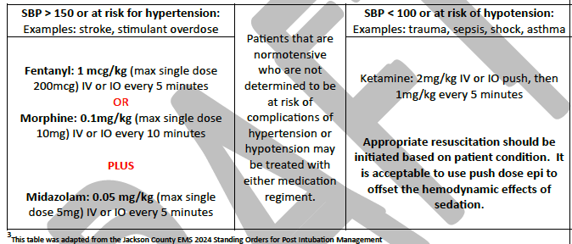
T715: SEDATION AFTER INTUBATION
Notes:
In patients with a systolic blood pressure of greater than 100, and less than 150, either ketamine or the combination of an opiate plus midazolam may be given.
In patients with a systolic blood pressure greater than 150, or at risk for hypertension, such as stroke or stimulant overdose, the paramedic has the option of midazolam plus either morphine or fentanyl.
In patients with a systolic blood pressure of less than 100, or are at risk of hypotension, such as trauma, sepsis, asthma, ketamine is preferred. Ketamine may be used with push-dose epinephrine in this population if needed.

Slide 15
UPDATED PROTOCOLS
2026 EMS Protocols | Academy of Medicine of Cincinnati
Notes:
Now for the updates!

Slide 16
A101: PREHOSPITAL COMMUNICATION
  Verbal reports should be given in the MIST-R format:
  Mechanism of Injury or Medical Complaint
  Injuries or Illness
  Signs (vital signs)
  Treatment
  Resources (upon arrival to hospital if needed)
Notes:
A101 spells out our Prehospital Communications. The regional EMS coordinators request that reports be formatted in the M I S T R or “mister” format. This stands for mechanism of injury or medical complaint, injuries or illness, signs such as vital signs, treatment for anything provided, and resources if any are needed on presentation to the hospital.

Slide 17
A102: PHARMACOLOGIC ASSISTED INTUBATION
  Added additional clarifications around the recommendations for any department-specific protocol.
  Added clarifications for KY based providers.
Notes:
While the Academy of Medicine does not have a specific rapid sequence intubation protocol, the Academy has made adjustments to our administrative recommendations surrounding pharmacologic assisted intubation. Additionally, Kentucky specific language was added.

Slide 18
A108: USE OF EMS FOR EMERGENT IFT
  Expanded existing protocol to provide clarity on requirements for EMTALA compliant transfers.
  Does NOT obligate emergency ambulances from performing IFT’s.
  Providers do not have to take medications/equipment that they are unfamiliar with.
  Ensure you have adequate written orders from transferring facility for any treatments outside of protocol.
  You cannot exceed your scope of practice.
  If hospital staff accompanying, paramedic is the primary decision-making authority.
Notes:
The realities of our healthcare system is that sometimes patients need to move from one hospital to another quickly. In an effort to protocolize this process, A108 was renamed “Use of EMS for Emergent Interfacility Transfer.
The protocol now references the requirements of EMTALA, ensuring that this law is followed. Importantly, this protocol does NOT obligate a department providing 911 services to perform these transfers.
Providers do not have to take medications or equipment that they are unfamiliar with. It is important that the crew receive written orders from a physician at the transferring facility for any treatments outside of protocol. It is extremely important that each member of the crew knows their scope of practice, and does not exceed that ceiling despite an order.
Lastly, this protocol spells out that during an interfacility transfer, the lead paramedic retains the primary decision making authority, not hospital staff.

Slide 19
A109: ADVANCED EMT
  Added state-specific scopes of practice and approved medications.
  Protocol otherwise unchanged.
Notes:
A109, the Advanced EMT protocol, was enhanced adding in state-specific scopes of practice and approved medications.

Slide 20
SB204: CARDIAC ARREST
  New information added in the Notes section, I.
    CPR Induced Consciousness
      Extremity movement, attempting to rise, purposeful movements, gag reflex, vocalizing distress
      Continue providing CPR despite consciousness as this is what leads to this state.
      Confirm that this is CPR-IC as the patient should become unresponsive when pulse/rhythm checks occur.
      If CPR-IC occurs consider administering midazolam 2-5mg IV/IO every 10 minutes if CPR-IC interferes with CPR.
      Restraints may be needed.
Notes:
SB204 cardiac arrest had a significant update. As prehospital care of cardiac arrest has improved it has created a new phenomenon. Our CPR has gotten good enough that in some patients some degree of consciousness may occur with the improved cerebral perfusion.
These patients may exhibit extremity movement, attempt to sit up, make purposeful movements, develop a gag reflex, and may vocalize distress. Despite these findings, continue to provide CPR. At the next rhythm check, if these signs cease when CPR stops, this may be CPR induced consciousness.
If you encounter CPR induced consciousness, paramedics may administer midazolam 2-5mg IV/IO every 10 minutes if this consciousness interferes with CPR. In some cases, restraints may be needed.

Slide 21
C302: BRADYCARDIA
  Under EKG findings, wording added ”heart rate typically <50 if bradyarrhythmia.”
  Clarified that obtaining a diagnostic EKG can be done only if it does not delay therapy.
  Paramedics no longer have to call medical control prior to giving medications or pacing.
  Pacing pads should be placed Anterior-Posterior.
  Note made that many devices default to “demand” pacing. May need to change to “non-demand” pacing.
Notes:
The bradycardia protocol, C302 had a few clarifications added. Wording was added that in these patients the “heart rate typically is less than 50 if in a bradyarrhythmia”.
Paramedics should not delay treatment to obtain a diagnostic EKG. They also do not have to call medical control prior to initiation of medications or pacing.
Pacing pads should now be placed anterior-posterior. The Academy was also made aware that some manufacturers monitors default to “demand” pacing. This may mean that the monitor may not adequately pace if the software becomes confused over a ventricular beat or artifact from movement. If you encounter this, and there is sudden loss of electromechanical capture, you may need to change your device to “non-demand” or “asynchronous” pacing. Speak to your department about your specific device.

Slide 22
C305: NARROW COMPLEX TACHYCARDIA (STABLE)
Continue to use the modified Valsalva maneuver as the initial treatment for SVT.
Adenosine dosing is changed to partially weight-based:
    If <90kg (200lbs), initial dose remains 6mg followed by an additional 12mg if unsuccessful.
    If >90kg (200lbs), both doses are now 12mg.
Notes:
C305, stable narrow complex tachycardia was updated to reflect a weight-based approach to the initial adenosine dose.
In patients who weigh less than 90kg or 200 pounds, the first dose remains 6mg. If ineffective, a second dose of 12mg may be given.
In patients who weigh over 90kg or 200 pounds, the initial dose is now 12mg, which may be repeated once if ineffective.
A reminder to all that the modified Valsalva maneuver should be attempted before medication.

Slide 23
C307: POST-ROSC CARE
  Criteria for ETCO₂ updated.
      Target is 35-45mmHg once effective circulation established.
      Sudden fall in ETCO2 may indicate impending arrest.
      Ventilation should only be titrated once effective perfusion and ventilation established.
  Reference is made to T715: Sedation after Intubation.
Notes:
C307, post return of spontaneous circulation care, had a few updates.
Goal end-tidal capnography target is 35-45 mmHg, however that is only after effective circulation is established. Once the patient’s perfusion and ventilation are stabilizing, providers may begin titrating ventilations to this goal.
A reference was also added to the new sedation after intubation procedure.

Slide 24
M408: RESTRAINT
  A more objective way of determining level of agitation was added: the RASS Scale.
      0 – Alert and Calm
      +1 – Restless, anxious, apprehensive but movements are not aggressive or vigorous.
      +2 – Agitated, uncooperative, resists care, frequent non-purposeful movement.
      +3 - Very agitated, cannot focus, pulls/removes equipment, fights environment.
      +4 – Combative, violent, immediate danger to staff
Notes:
In the continuing evolution of our Restraint protocol, a new method of assessing levels of agitation was added. The Richmond Agitation-Sedation Scale has been used elsewhere in healthcare for some time. This takes our previous observations and provides an objective score that can guide treatment.
Patients with a RASS of 0 are alert and calm.
Patients exhibiting restlessness, anxiousness, apprehension but movements are not aggressive or vigorous are a +1.
Patients with a RASS of +2 are now more agitated, uncooperative, may resist care, and have frequent non-purposeful movement.
A patient with a RASS of +3 are pulling at equipment, may fight their environment, cannot focus, and are very agitated.
When patients become combative, violent, and present an immediate danger to staff, they are scored +4.

Slide 25
M408: RESTRAINT
  For RASS +2: midazolam 5mg IM. For smaller adults and elderly consider a lower dose.
  For RASS +3: midazolam 10mg IM. For smaller adults and elderly, may use 5mg.
  For RASS +4: consider administering ketamine 4mg/kg IM ideal body weight, or as indicated in the dosing chart.
Notes:
Now that we have an objective score, we can more easily titrate our treatment to the patient. In all of these cases, if you have a smaller adult, or an elderly patient, the dose may be reduced if needed.
For a RASS of +2, these patients may be given midazolam 5mg IM.
For a RASS of +3, midazolam is now 10mg IM.
In patients with a RASS of +4, those that are an immediate danger to staff, ketamine at 4mg/kg ideal body weight, or as indicated in the dosing chart, may be administered.
It is imperative that you document a RASS score in your report if chemically restraining a patient.

Slide 26
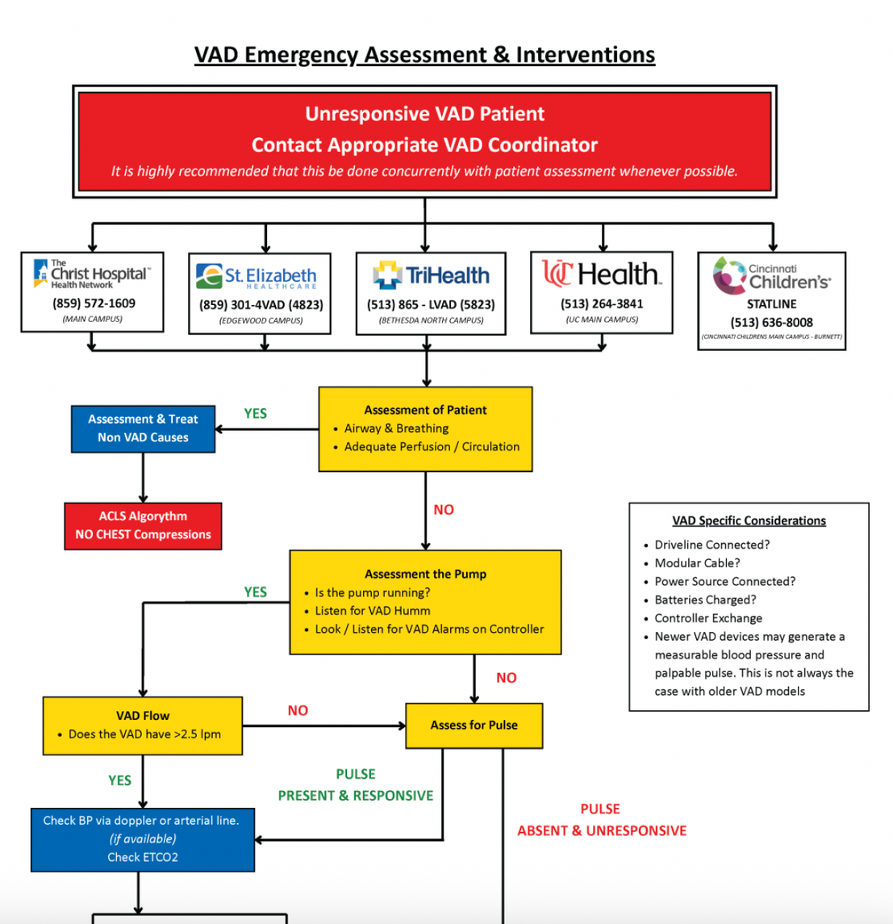
M415: PRE-EXISTING MEDICAL DEVICES
  New flowchart added for care of an unresponsive ventricular assist device (VAD) patient care.
Notes:
M415, which deals with pre-existing medical devices, is where we turn for any ventricular assist device concerns.
A new flowchart has been added on how to care for these patients in the unresponsive VAD patient. It also includes the VAD coordinators number to assist in management. An important point is that the flowchart only applies to ADULT patients. For pediatric VAD patients, please call the Children’s VAD team.

Slide 27
S504: EYE INJURIES
  Clarified language.
  Added a timeframe for eye irrigation: at least 15 minutes.
Notes:
S504, Eye Injuries had some language clarifications. It now also spells out that irrigation should occur for at least 15 minutes.

Slide 28
S508: EPISTAXIS
  Added option of using TXA via atomizer device as a second line treatment if initial medications unsuccessful.
      Take undiluted contents of vial and put into syringe.
      Using atomizer attachment, instill 0.5mL into the bleeding nostril.
  Continue to use nasal clips throughout.
Notes:
To couple with our new superficial TXA protocol, S508 Epistaxis was updated. If your initial medication and clamping is not successful in stopping the nose bleed, paramedics now have the option of administering intranasal atomized TXA.
To do this, take the undiluted contents of the TXA vial and put it into a syringe. Attach the atomizer, and instill 0.5mL into the bleeding nostril. If unsure on which is bleeding, it may be applied to both. Reclamp the patient following administration.

Slide 29
P601: PEDS VF/VT ARREST
  Added “After resuscitation has been initiated, arrange for early transport and notify receiving hospital.”
  VF/VT is a rare occurrence in children.
Notes:
Cincinnati Children’s added language to P601, pediatric v-fib/v-tach arrest protocol. It now includes: “After resuscitation has been initiated, arrange for early transport and notify the receiving hospital.” V-fib and V-tach are rare in children.

Slide 30
P605: PEDIATRIC STRIDOR
  Inclusion criteria reorganized:
A. Age 6 months to 6 years.
B. Barky “seal” sounding cough.
C. Stridor at rest.
D. Retractions in chest or neck
E. May have fever and cold symptoms.
F. No history of foreign body aspiration.
  Differential diagnosis reorganized:
1. Croup
2. Foreign Body Aspiration
3. Epiglottitis
4. Bacterial tracheitis
5. Asthma
6. Anaphylaxis
Notes:
P605, pediatric stridor, had minimal changes. The inclusion criteria and differential diagnosis within the flow chart were reorganized.

Slide 31
P617: PEDIATRIC BRUE
  Added in that routine transport is recommended even if the child is not deemed HIGH RISK.
  Contact medical control prior to obtaining refusal.
Notes:
P619, pediatric BRUE, adds that routine transportation is recommended of these patients even if the child is not deemed HIGH RISK. If caregivers still want to refuse, contact medical control as they may be able to change their mind.

Slide 32
T713: MECHANICAL VENTILATOR SETUP AND MANAGEMENT
  Name changed to better reflect its’ purpose.
  Clarification made for overall standards.
  Section that EMT’s may perform added.
      Call for ALS backup.
      If vent malfunctioning or pt in respiratory distress, remove them from the ventilator and manually ventilate.
      If pt stable on vent, and patient’s family or caregiver can monitor ventilator, EMT’s may begin transport with patient on their own ventilator.
Notes:
Our existing T713, mechanical ventilator setup and management had a few changes. Some clarification was added to the name and the overall standards for use.
An EMT section was broken out. This spells out that EMT’s should still request ALS backup. It authorizes EMT’s to remove patient’s from ventilators and manually bag them if the ventilator is malfunctioning or the patient is in respiratory distress.
If a patient is stable on the ventilator, and patient’s caregiver can manage the ventilator, EMT’s may begin transport with the caregiver, using the patient’s normal ventilator.

Slide 33
APPENDIX A: CHEMICAL AGENT EXPOSURE
APPENDIX B: TRANSPORT OF CONTAMINATED PT.
  Changed acronym to DUMBELS.
  Defecation
  Urination
  Miosis
  Bradycardia, Bronchorrhea
  Emesis
  Lacrimation
  Salivation
  National poison control number and local number added.
  WISER application no longer exists.
Notes:
Appendix A, chemical agent exposure, and Appendix B, Transporation of the contaminated patient are protocols none of us want to ever use. Regardless, it’s important that we recognize the signs of nerve-agent or organophosphate poisoning. Dr. Otten has recommended we switch to the nemonic DUMBELS.
This stands for
D-Defecation
U-Urination
M-Miosis or pinpoint pupils
B-Bradycardia or Bronchorrhea
E-Emesis
L-Lacrimation
S-Salivation
The national poison control phone number and the local number were added to the protocol.
The reference to the now sunset WISER application was removed.

Slide 34
APPENDIX E: IMMUNIZATION
  Added more state-specific information.
  OH-ALL: If medical director approves, and publishes a protocol, EMT’s and above may administer any vaccine whose route is in their scope of practice.
Notes:
Our last protocol is Appendix E, immunizations. The core content of the protocol remains unchanged. State specific information for Kentucky and Indiana are also unchanged. For Ohio providers, EMT’s and above are now permitted, if the medical director approves, and publishes a protocol, to administer any vaccine whose route is in their scope of practice.
It is important to note that administering vaccines routinely carries significant administrative burden.

Slide 35
THANK YOU
If you have additional questions, please reach out to your medical director or your normal chain of command.
2026 EMS Protocols | Academy of Medicine of Cincinnati
Notes:
And that concludes our 2026 Academy of Medicine of Cincinnati Prehospital Clinical Practice Guidelines. Thank you for your attention.
If you have any questions regarding this content, please reach out to your medical director, or your normal chain of command.

