Slide 1

M420: Opioid Withdrawal
Thomas E. Charlton, MD
Co-Chair, Academy of Medicine Protocol Committee
Portions of this lecture were used with permission from Jordan Singer, MD University Hospitals, Cleveland.
Notes:
Hello, this is Dr. Tom Charlton, co-chair of the Academy of Medicine of Cincinnati’s Protocol Committee. This module is an added training for the 2026 protocols, intended for use by departments that are starting buprenorphine field administration programs.
I want to thank Dr. Jordan Singer, an EMS physician from University Hospitals in Cleveland for his permission to use portions of his own buprenorphine training module.
The buprenorphine program we will discuss today is based on the California BRIDGE program, started several years ago by the State of California. This model is widely accepted, and has significant research backing its safe use. It also will serve as the State of Ohio’s groundwork for our own statewide whitepaper.

Slide 2
Disclosures
None
Notes:
I do not have any disclosures.

Slide 3
Objectives
Trained on pathophysiology of opioid abuse
Reduce stigma around substance use disorder
Understand the new opioid withdrawal protocol
Successfully apply the COWS score
Make appropriate referrals to outpatient treatment
Notes:
At the end of today’s training you should be trained on the pathophysiology of opioid use. You should understand the stigma associated with substance use disorder. You will understand the new opioid withdrawal protocol, be able to successfully apply the COWS score, and understand your agency’s referral process for outpatient treatment.

Slide 4
Pathophysiology of opioid poisoning
Opioid goes to brain → stimulates mu opioid receptor
  Pain relief
  Decrease respiratory drive (brain stem)
  Direct effect on “wakefulness” systems
  General CNS depression
  Opioid → CNS depression → Unconscious → Respiratory Depression
Notes:
The human body has distinct opioid receptors with differing functions. The human body produces its’ own endogenous opioids, however we can also administer exogenous opioids that will bind to these receptors.
The most common receptor is the mu opioid receptor. When triggered it provides pain relief, causes euphoria, and has sedative properties. In medicine we frequently use compounds that bind to this receptor to control pain, and occasionally will use it in combination with other medications to sedate patients for procedures.
As more of the mu receptors are bound, the effects strengthen which can lead to CNS depression. The patient will then slip into unconsciousness, and sometimes will have respiratory depression or respiratory arrest.
It is primarily the respiratory depression or arrest that kills patients in an acute overdose situation.

Slide 5
Naloxone (Narcan)
MOA: opioid antagonist that displaces opioids at the opioid receptor sites
How does naloxone treat unconsciousness?
  Naloxone removes opioid from receptor → patient starts ventilating normally → CO2 level decreases → CNS depression improves
While awaiting the Narcan to take effect what should we do?
Notes:
Luckily, we have other compounds that antagonize the opioid receptors as well. Naloxone or Narcan is the most commonly used of these medications. Naloxone binds to the mu receptors, causing the opioid to detach. As the naloxone binds to more receptors, the opioid affects lessen. The patient begins to ventilate more normally, causing carbon dioxide levels to decrease, and improving the patients CNS status.
When we encounter an acute opioid overdose, it is important to remember that the patients breathing and airway should take priority over naloxone administration. Naloxone does not have immediate effects, however temporizing things with bag-valve-mask ventilation and simple airway maneuvers can improve things within seconds.

Slide 6
How to treat unconsciousness?
If OD suspected, support the airway including BVM.
Administer Narcan per protocol.
Continue to support the airway and administer additional Narcan if needed.
Notes:
When encountering the unconscious patient, opioid overdose is among the differential diagnosis. Start by providing respirations, support the airway, and administer naloxone. Sometimes additional naloxone is required. When determining how much naloxone to provide the patient, it is important to take into account how much may have been administered prior to our arrival. Naloxone is widely available to the lay-public and our law enforcement colleagues.

Slide 7
Naloxone Kinetics
Onset of action
IV: ~2m
IM: 2-5m
IN: 8-13m
We should not re-dose meds before these times
Duration of peak effect: ~2 hours
Opioid duration often >2hrs
If refuse transport → risk of becoming unconscious
Studies have shown that risk of respiratory depression following Narcan is low to zero.
Notes:
To appropriately administer naloxone, we must understand the kinetics of the medication. Today, many patients will receive naloxone via the intranasal route. This route is widely available, but takes 8-13 minutes for effectiveness. Dosing before the medication has been allowed to work does not speed up the process. Give the medication time to work before administering more.
Naloxone has its’ peak effect for approximately two hours. Several retrospective studies have demonstrated that the risk of having respiratory depression requiring additional Narcan after the original Narcan is metabolized is low to zero. However, we still need to attempt to transport these patients for monitoring, connection to treatment, and treatment of other comorbid conditions.

Slide 8

Naloxone complications
Pulmonary edema
  Not due to heart failure
  Unclear if from naloxone or the opioid OD itself
  Treatment: positive pressure ventilation
Precipitated opioid withdrawal
  Occurs if opioid dependent (not if occasional user)
  Lower doses naloxone → less likely to induce w/d
  Goal: improve ventilation, but NOT induce w/d
Notes:
When giving naloxone, there are two complications that we must be aware of. Pulmonary edema can occur following administration, however it is not known whether this is the naloxone itself or the opioid overdose is the cause. The treatment is positive pressure ventilation.
Naloxone, especially when administered at higher doses, may precipitate withdrawal. This is more common in those dependent on opioids as opposed to the casual use. The goal when administering naloxone is to improve the patient’s ventilation. We should not aim to wake the patient up, as this increases the risk of precipitated withdrawal. As long as the patient is breathing adequately and protecting their airway, additional naloxone should not be administered.

Slide 9
Goal of giving naloxone
Goal: reverse hypoventilation
  Not to fully reverse all effects of opioids
  If breathing normally but drowsy → naloxone NOT needed
Notes:
A common misconception is that we should give enough naloxone to “wake the patient up”. This is not true, and again, raises the risk of precipitated withdrawal. Precipitated withdrawal has an entirely new set of concerns, and should be avoided.

Slide 10
Field treatment of opioid OD
Supplement ventilation with BVM
  #1 priority
  Reverses a component contributing to unconsciousness, acidosis and hypoxia
  Prevents cardiac arrest from opioid OD
  Consider OPA or NPA
Place nasal ETCO2
  Ensure good seal and quality ventilations
  Tells you what the CO2 is
    We care what the blood CO2 level is
    ETCO2 can be higher than blood CO2 but never lower
  Bag the patient to a normal ETCO2 (35-45)
Notes:
To summarize the treatment of opioid overdose, airway and breathing are our number one priority. Nasal ETCO2 can help guide our ventilations, with a goal of 35-45.

Slide 11
Field treatment of opioid OD
Consider naloxone
  Should not occur before ensuring quality ventilation
  Dose:
    IN: 0.4 mg to 4mg
    IV/IM/IO: 0.4 mg to 4mg
  Protocol allows repeat every 3-5m to max of 10mg BUT this does not mean you SHOULD
  Remember IN/IM takes >8m to work.
Notes:
Once the airway and breathing are controlled, naloxone should be administered. Our protocol calls for 0.4-4mg via all normal routes such as intranasal, intramuscular, intravenous, via IO. A reminder that EMT’s are only permitted to administer naloxone via the intranasal route, or to use a pre-loaded automatic device intramuscularly. The maximum dose total is 10mg. If the patient has not responded to the naloxone by that time, there may be other conditions at play. You should use the lowest dose required to stabilize their ventilations and airway.

Slide 12
What if patient arrests?
Standard cardiac arrest care
How does naloxone fit into cardiac arrest care?
  Naloxone not listed in our cardiac arrest protocols
  Naloxone reverses opioid induced respiratory depression
  In cardiac arrest: apnea due to pulselessness → naloxone will not help breathing or circulation
  Naloxone will not hurt but also won’t help → should never take priority over more important interventions
    Compressions, BVM, IV access for epi, airway mgmt., ect.
Notes:
A frequent concern is how to handle the cardiac arrest encountered during a suspected opioid overdose. These cardiac arrests should be managed as normal. Naloxone is not going to cause the arrested patient to being breathing or regain pulses. No studies have demonstrated improved outcomes from naloxone administration in an arrest.

Slide 13
Opioid Use Disorder (OUD)
What is OUD?
  Any patient who is using opioids in a dangerous way
  Patients with at least 2 of the following are defined as having OUD
    Opioids taken in larger amounts over longer periods of time than intended
    Persistent desire or unsuccessful efforts to cut down on use
    A great deal of time spent trying to obtain opioids, use opioids or recover from effects
    Craving or strong desire to use opioids
    Recurrent opioid use resulting in failure to fulfill major obligations at home, school or work.
    Continued use despite recurrent problems caused by or worsened by opioid use
    Important activities given up on or reduced because of opioid use
    Tolerance to opioids
    Symptoms of withdrawal when not using
  Any patient that has EMS activated for an opioid related concern likely has OUD
Notes:
Now that we know how to treat the opioid overdose, we need to discuss opioid use disorder. This is characterized as a patient using opioids in a dangerous way, or two of the following: ingestion of opioids in larger amounts over longer periods of time than intended; desire to cut down on use; significant time spent trying to obtain opioids; craving opioids; opioid use that interferes with home, school or work; continued use despite negative consequences; tolerance to opioids; or symptoms of withdrawal when not using.
Most of our patients with an acute opioid overdose will likely also have opioid use disorder.

Slide 14
Epidemiology of OUD
6.6 million ppl in the US are estimated to have used heroin at some point in their lives (2.3% of those age 12 and up)
Between 2002 and 2018, prevalence of heroin use doubled
OUD does not discriminate!
  Affects all races
  Affects wealthy and poor
  Affects people of all ages (including the very elderly)
  Affects all religions
  Affects all communities
Notes:
In the United States, approximated 6.6 million people have opioid use disorder. As we are all aware, between 2002 and 2018 the use of “heroin” doubled. The heroin currently available is commonly adulterated with fentanyl, carfentanyl, or xylazine. These compounds are much more potent than pure heroin (diamorphine). As a result, overdoses have increased significantly as even minor alterations in the makeup of the “heroin” can have profound potency consequences.
Opioid use disorder does not discriminate. It affects all races, all ages, all religions, all communities, regardless of whether wealthy or poor.

Slide 15
Health consequences of OUD
Overdose
Infection from IV drug use
  Endocarditis
  Serious skin and soft tissue infections
  Spine infections
  HIV and Hepatitis
Negative implications of spending majority of money on opioids
  Exposed to violence from illicit sellers
  Prostitution
  Homelessness
  Poor nutrition
Notes:
Opioid use disorder has long-term health consequences. Patients using the intravenous route have significant risk of developing endocarditis, spine infections, blood infections such as HIV and hepatitis, and serious skin and soft-tissue infections. Some of these conditions can lead to death.
There are also other negative consequences such as increased exposure to violence, prostitution, homelessness, and poor nutrition.

Slide 16
Why do those with OUD continue to use opioids despite all the negatives?
Brain chemistry has changed
  Makes stopping VERY hard
  Also makes relapse very easy for those that have been able to stop
Many are terrified of opioid withdrawal
  Opioid withdrawal cannot kill you, but it makes patients feel like they are dying
  Fear of opioid withdrawal > enjoyment of the opioid
Often have medical problems that cause severe pain
  Many patients develop OUD secondary to scripts to treat actual painful issues
  Trying to cut back → experience actual severe pain that is difficult to treat
Notes:
If the consequences of opioid use disorder are so bad, why do people continue to use? As in most medical conditions, our chemistry has a role. In opioid use disorder our brain chemistry fundamentally changes. This means patients develop tolerance, therefore needing higher doses, and become dependent on opioids to feel “normal”. These changes also make patients more susceptible to relapse.
Opioid withdrawal is an extremely uncomfortable experience. While withdrawal will not kill the patient, it makes them feel like they will. Many times continued opioid use is because of the fear of withdrawal rather than the euphoria it once caused.
Many times these patients may have severe pain comorbidities that led to their substance use disorder. The brain, in an attempt to be “normal” also increases the amount of mu receptors. This leads to tolerance, but also means that patients have their pain thresholds lowered significantly. In other words, they become more sensitive to pain, especially when withdrawaling.

Slide 17
Why do those with OUD continue to use opioids despite all the negatives?
Patients with OUD often are in social circles where others also have OUD.
  It is very hard to stop using opioids when your friends (or significant other) also uses
  Sobriety might also mean cutting ties with their entire support network → maintaining sobriety even harder
Notes:
There are social consequences to opioid use disorder as well. Many times patients will find themselves surrounded by others with substance use disorder. It is extremely difficult to get sober when everyone around you continues to use. Patients may have to cut ties with all of their friends that continue to use in order to achieve sobriety.

Slide 18
Stigma can be very harmful to patients
These patients have a condition called OUD
  We should not refer to them as addicts, drug users, etc. → implies a character flaw
  The goal is sobriety, not getting clean. Using the word clean implies that those with OUD are dirty, which they are not.
  The words that you use matters!
No one plans to get OUD
  Sometimes the circumstances of their lives lead to them developing it
Showing even a little respect and empathy can be powerful!
  Patients with OUD are not proud to overdose or to have this condition, we do not need to make them feel any worse than they already do
  A little respect/empathy → build a strong therapeutic relationship → allow you to positively influence their life
Notes:
Unfortunately, significant stigma has developed around all substance use disorders. Many people believe that it is a personal choice to continue to use. As a result, pejorative terms such as “addicts”, or drug users may be used. Substance use disorder is not a character flaw: it is a treatable disease. The goal is achieving sobriety, not getting “clean”.
Because of the stigma, many patients suffering from substance use disorders are embarrassed to have the disease, have had bad interactions with society and medicine, and may be defensive because of these experiences. Showing respect and empathy towards these patients will help establish a rapport giving us an opportunity to intervene.
Treat these patients just as you would treat any other disease. We do not make fun of the heart attack victim because they had one.

Slide 19
OUD is a chronic medical condition
Once a patient has OUD, they always have OUD
  Brain chemistry has changed → if they achieve sobriety they are still at risk to relapse
  That is OK! Sobriety is hard and relapse is a set back. We need to help them reach sobriety again.
Patients with diabetes and hypertension can have times when their disease is not well controlled for a variety of reasons → OUD is no different
Just like most other chronic medical conditions, there are treatments for OUD!
  Buprenorphine (Suboxone) → more on this later
  Methadone
Notes:
Opioid use disorder is a chronic medical condition. Their brain chemistry is fundamentally changed, and relapse is a real risk. It is normal for a patient to relapse 3-5 times before achieving long-lasting sobriety. Just as with diabetes, opioid use disorder can become uncontrolled until adjustments are made. We are fortunate to have treatments available for opioid use disorder.

Slide 20
What is opioid withdrawal?
Set of symptoms arising from the sudden withdrawal or reduction of opioids in patients who are opioid dependent
  Opioid dependence occurs in patients who have used opioids for a prolonged period and have become tolerant → needing higher doses for the same effect
  Can take <1 week to develop tolerance and dependence with regular use
Symptoms of opioid withdrawal
  Lacrimation
  Rhinorrhea
  Piloerection
  Myalgias
  Diarrhea
  Nausea/Vomiting
  Dilated pupils
  Photophobia
  Insomnia
  Autonomic hyperactivity
Notes:
In order to successfully treat these patients it is important to know the signs of withdrawal. Patients that use shorter-acting compounds may develop symptoms in a matter of hours. Those using longer-acting compounds may take several days. Nearly all patients will develop withdrawal symptoms in less than one week.
The symptoms of opioid withdrawal are a result of the various opioid receptors no longer being triggered. This includes:
Lacrimation, rhinorrhea, piloerection, myalgias, diarrhea, nausea and vomiting, dilated pupils, photophobia, insomnia, and autonomic hyperactivity.

Slide 21
What is opioid withdrawal?
Can opioid withdrawal be fatal?
  The withdrawal itself is not fatal
  Patients often feel as if they are going to die → driven to use opioids to treat withdrawal → accidently OD and die
  Even though opioid withdrawal itself is not fatal → it is still dangerous for patients
How long does it take for withdrawal to start?
  Depends on which opioid is used
  Short-acting agents → <24 hours
  Long-acting agents → >24 hours
Notes:
These symptoms can make the patient feel as if they are dying. Opioid withdrawal itself is not fatal. It can still be dangerous for patients, and at the very least is very uncomfortable. Having compassion for these patients and treating them with dignity during their withdrawal has profound impacts.

Slide 22
What is opioid withdrawal?
Two ways patients go into withdrawal
  Patients stop using opioids
    Prescription ran out, ran out of money to but more, patient trying to stop using, ect
  Precipitated withdrawal from naloxone
How do we measure severity of opioid withdrawal?
  Clinical Opioid Withdrawal Scale (COWS)
Notes:
There are two primary ways that patients suffer from withdrawal: stopping use, or having withdrawal precipitated by medications such as naloxone.
To better objectivity the “severity” of the withdrawal, the Clinical Opioid Withdrawal Scale or COWS, was developed.

Slide 23
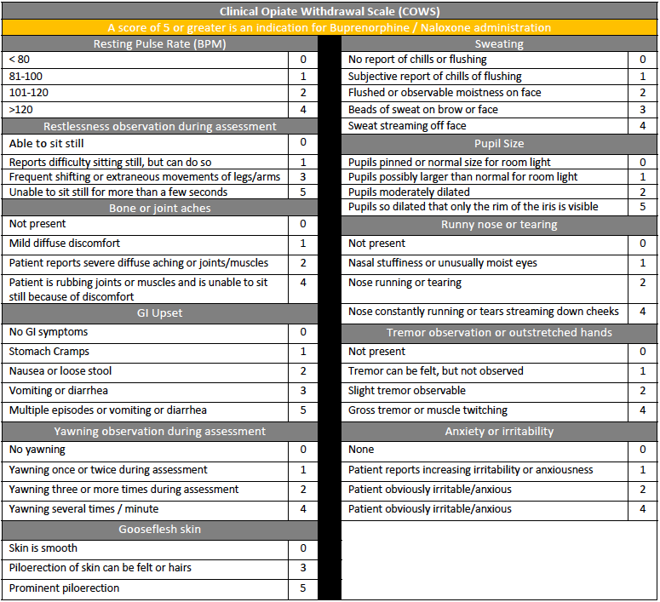
Clinical Opioid Withdrawal Scale (COWS)
Degree of withdrawal
  <5 = no active w/d
  5-12 = mild
  13-24 = moderate
  25-36 = moderately severe
  >36 = severe
Notes:
The COWS score has five “levels” within it: no active withdrawal, mild, moderate, moderately severe, and severe. The score is based on measurements in multiple categories, which we will get into shortly.

Slide 24
How can we treat opioid withdrawal?
You can treat each symptom individually
  Nausea/vomiting → ondansetron
  Diarrhea → loperamide
  Piloerection and agitation → clonidine
Use medication assisted therapy
  Methadone = long-acting opioid
    Stimulates the mu receptor → treating the withdrawal
    Does not get people very high → can have a functional life
    Possible to overdose/abuse
  Buprenorphine (Suboxone)
Notes:
The treatment of opioid withdrawal ranges widely. Prior to the advent of better treatment programs, we used to simply treat the individual symptoms causing distress. Patients with diarrhea were put on loperamide. Those with nausea and vomiting were given ondansetron. Agitated patients were started on clonidine. None of these combinations was very effective, and could only be used during the withdrawal phase.
Modern treatment is focused on both preventing withdrawal symptoms, and harm reduction.

Slide 25
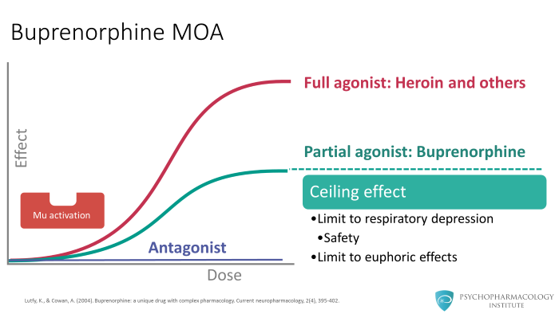
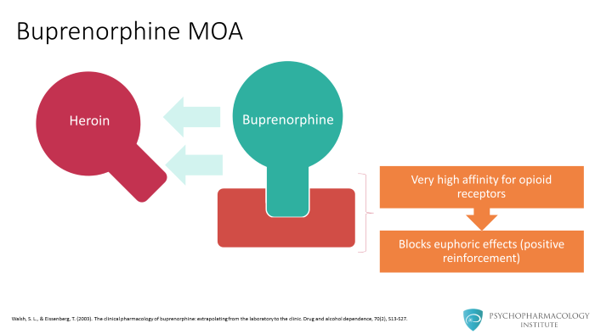
Buprenorphine
Brand for combo with naloxone: suboxone
MOA: partial agonist to opioid receptor with VERY strong affinity
Benefits
  Treats opioid withdrawal
  Decreases cravings
  Prevents opioid overdose
Notes:
Buprenorphine is an opioid compound that only partially activates the mu receptors. However, it has a very strong affinity for binding. This means that it can displace existing opioids, but does so without significant risk. It has a ceiling effect that limits respiratory depression, and limits euphoric effects. It increases safety for the patient as even if they relapse and use while on buprenorphine, the other drugs cannot push the buprenorphine off of the receptor. This means that their body does not respond nearly as strongly, and often prevents euphoria and respiratory depression. By binding the mu receptors, buprenorphine prevents withdrawal, reduces cravings, and prevents further opioid overdose.

Slide 26
How is buprenorphine used in OUD?
Treats opioid withdrawal
  Patients often use opioids to prevent withdrawal
  By treating withdrawal → patients have less of a reason to continue to use opioids
  Withdrawal makes patients feel like they are dying → buprenorphine directly treats withdrawal to reduce suffering
Decreases cravings
  Less cravings leads to less of a chance that the patient relapses
Notes:
By treating the withdrawal symptoms, we lower one of the barriers to sobriety: fear of withdrawal. Patients supported with buprenorphine are much more likely to maintain sobriety in the long-term, and have lower overall mortality rates compared to those continuing to use. Because buprenorphine reduces cravings, it also means that patients are less likely to relapse.

Slide 27
How is buprenorphine used in OUD?
Prevents opioid overdose
  Given buprenorphine binds to the mu receptor more strongly that most opioids, if a patient on buprenorphine relapses → opioid they take cannot exert its effect since buprenorphine is already bound → unlikely to OD
  Highest risk time for OD is during a relapse
    Patient no longer has same tolerance as before → accidently overdose since might take similar dose to before
    Regular buprenorphine use specifically works to prevent this type of overdose
Notes:
As previously stated, buprenorphine binds so strongly to the mu receptor that most other opioids are unable to push the medication off. The receptors are saturated and bound, meaning other opioids cannot fully agonize or trigger the receptor which would lead to potential overdose.
The highest risk to a patient for overdose is during a relapse. The patient may have previously been using a given dose. Their body does not have the same tolerance as before, so what previously was a “safe” dose for them may lead to overdose. By having buprenorphine present, we can prevent the positive feelings associated with use, and at the same time block the deleterious effects.

Slide 28
How is buprenorphine given?
Dissolvable oral medication that is given once or twice a day
  Dissolvable film or dissolvable tablet
Why does Suboxone have naloxone in it?
  Naloxone has very low oral bioavailability → if taken oral, very little is absorbed into blood stream
  If a patient takes Suboxone (combined buprenorphine & naloxone), naloxone does very little, and buprenorphine exerts its intended effect.
  Suboxone can be melted and injected to induce a euphoric effect
  If a patient tries this with Suboxone, the naloxone is then being injected meaning it will exert its effect and prevent both the euphoria from the buprenorphine and overdose if enough is injected.
Notes:
Buprenorphine is available in several formulations. For outpatient treatment, tablets, oral films, or orally dissolving tablets are frequently used. Many times the buprenorphine will be combined with naloxone. This prevents overdose if a patient melts or dissolves the tablet into liquid and attempts to inject it. The naloxone is not able to be absorbed by the intestine, so when taken orally, it has no effect. However, when injected, it is able to get into the blood stream with the buprenorphine, preventing overdose.

Slide 29
Buprenorphine administration
Historically, patients needed to go to the hospital or an addiction clinic to be started on buprenorphine.
Requiring going to a formal healthcare center has limitations
  Not all patients who would benefit wanted transport by EMS
  Not all patients are able to self transport if they want to go later
  Result: missed opportunities to connect OUD patients with care
Use of buprenorphine has been demonstrated to decrease opioid related deaths.
  Increasing access to buprenorphine → save lives
EMS is perfectly positioned to meet this need!
Notes:
Until recently, there were significant regulatory hurdles to initiating someone on medication assisted therapy. Patients often had to go to a hospital or clinic for treatment. This is a barrier to many patients secondary to transportation issues, privacy concerns, work/life interference.
The use of buprenorphine is strongly associated with reduced deaths from opioid use.
EMS is uniquely positioned to interact with opiate use disorder patients, intervene to prevent further harm, and connect patients with outpatient treatment.

Slide 30
Why should EMS care?
Patients who OD have a 10% 1-year mortality
  1 in 10 patients you revive from opioid OD will be dead within 1 year
  Likely highest mortality of any patient who regularly refuses transport
EMS responders might be the only medical professionals who interact with these patients
  These patients frequently refuse care → some never interact with emergency department
  These patients rarely see primary care doctors
Your encounter with this patient might be healthcare’s only chance to help
  If OD once, very likely to OD in near future
Notes:
Patients who overdose have a 10% one-year mortality. This is likely the highest mortality of any of our patients that commonly refuse transportation.
These patients often have had multiple negative interactions with law enforcement and healthcare. They are often reluctant to be transported as a result. EMS may be their only contact with the health care system, and thus may be our only opportunity to help. Once a patient overdoses, they are far more likely to overdose in the future.

Slide 31
EMS Administration of buprenorphine
History
  Cooper EMS in Camden NJ creates and rolls out a protocol for EMS responders to administer buprenorphine in the field (2019)
  Our program is based on the State of California BRIDGE program.
Other protocols have required online medical control orders for giving buprenorphine .
  Our protocol will allow you to administer WITHOUT an online medical control order
Notes:
Multiple EMS agencies around the country began administering buprenorphine in the last decade. One of the first programs was in Camden New Jersey. The state of California has one of the most widely used programs called BRIDGE. Many prehospital protocols required involvement of medical control prior to giving buprenorphine. Ours does not require medical control as California’s program has demonstrated significant safety with this approach.

Slide 32
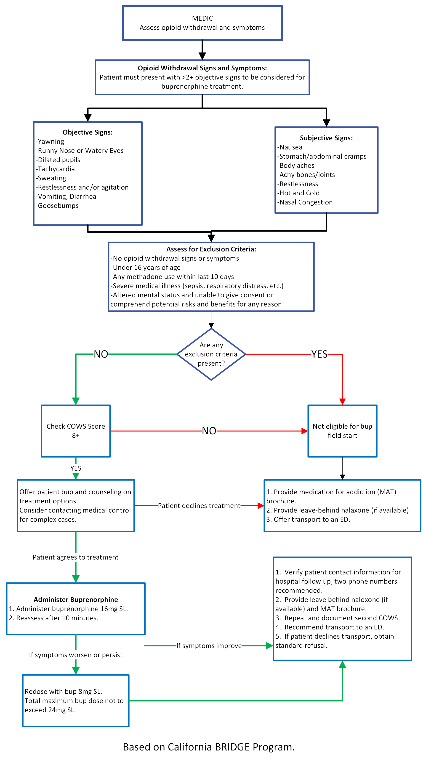
Our protocol
Advanced EMT’s/Paramedics only
  Not in scope of practice for EMT’s.
Notes:
Our Opioid Withdrawal guideline is for use by Advanced EMT’s and Paramedics only. It is important to know your states’ scope of practice.
Buprenorphine is not within the scope of practice for EMT’s.

Slide 33
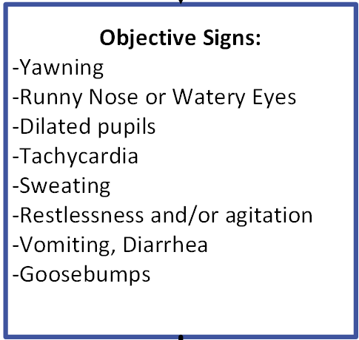
Inclusion Criteria
Patient has ≥2 objective signs
Notes:
We start with screening for withdrawal signs. The patient must have two or more of: yawning, runny nose, watery eyes, dilated pupils, tachycardia, sweating, restlessness, agitation, vomiting, diarrhea, or goosebumps.
If the patient has two or more, we move to the exclusion criteria.

Slide 34
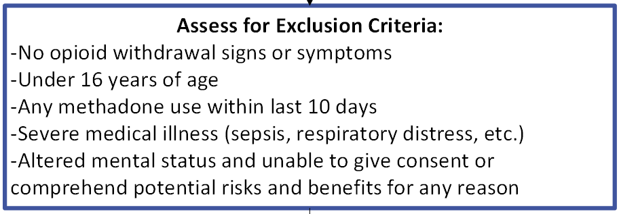
Exclusion Criteria
Notes:
We cannot use this guideline if the patient does not have signs of opioid withdrawal, is less than 16 years of age. If the patient has used methadone in the last 10 days buprenorphine can precipitate severe withdrawal and therefore precludes its’ use. Patients that have a severe medical illness such as sepsis or respiratory distress should not be started on buprenorphine. Lastly, patients with altered mental status, or those unable to give consent for treatment or lacking capacity should not be started.

Slide 35
Exclusion criteria
Purpose of the criteria
  Methadone dose <48 hours: methadone is a long-acting opioid. Even if COWS is high enough, large risk of precipitated withdrawal in these patients. After 48 hours, precipitated withdrawal unlikely.
  AMS & unable to consent: altered patients do not have the capacity to consent to getting buprenorphine. These patients will be transported since they cannot refuse. ED can discuss starting treatment once they have capacity
Notes:
Methadone is a long-acting opioid. As a result, even if the patient has an elevated COWS score indicating active withdrawal, buprenorphine administration will potentially make these symptoms worse. Any use within the previous 10 days can be associated with it, however the risk is highest in the first 48 hours following their last dose.
Altered patients do not have the capacity to understand the risks and benefits of starting this treatment. These patients should be transported to the ED, where we can discuss treatment when appropriate.

Slide 36
COWS
Apply the COWS score
COWS score is built into ESO and others.
Patient must have a COWS ≥ 8
  COWS < 5 → not in withdrawal
  Giving buprenorphine → precipitated withdrawal
  Higher the COWS → less likely to precipitate withdrawal
  If unsure about score, call medical control
Notes:
Now that we have screened the patient, we need to apply the COWS score to them. Luckily the score is already built into ESO and other ePCR platforms, however it may need to be turned “on”. Our guideline requires a COWS score of greater than or equal to eight. Patients with a score less than 5 are not in withdrawal. Giving these patients buprenorphine will precipitate withdrawal. As the COWS score increases, the likelihood of precipitated withdrawal decreases. If you are unsure about someones score or eligibility for treatment, contact medical control.

Slide 37
COWS Score
Resting heart rate
Sweating
Restlessness
Pupil size
Bone/joint aches
Runny nose/tearing
GI upset
Tremor
Yawning
Anxiety/irritability
Goosebumps
Notes:
The COWS score is based on several categories: resting heart rate, sweating, restlessness, pupil size, bone/joint aches, runny nose/tearing, GI upset, tremor, yawning, anxiety or irritability, and lastly goosebumps.

Slide 38
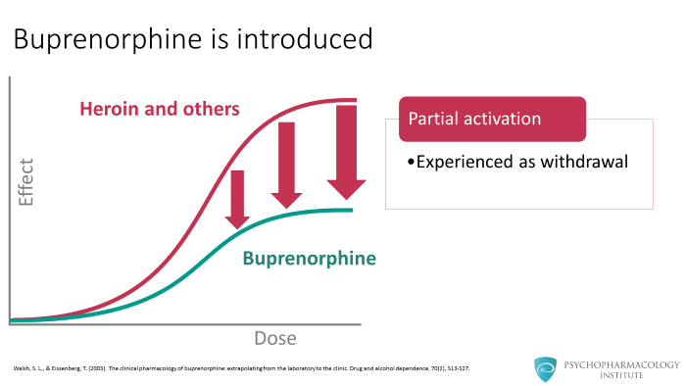
What is precipitated withdrawal?
Giving a patient a medication → induces immediate opioid withdrawal
  Naloxone
  Buprenorphine (if COWS too low)
Patients are very scared of precipitated withdrawal
  If COWS ≥ 5 → principiated w/d is unlikely
Notes:
Establish your COWS score. Do not forget that a COWS of less than 5 means they are not in withdrawal and we do not want to cause precipitated withdrawal. If they are not in withdrawal it is likely that a fully agonizing compound is on their mu receptor. If we replace that fully agonizing compound with buprenorphine, only a partially agonizing compound, the different degree of effect will be experienced by the patient as withdrawal.

Slide 39
Conversation
Discuss starting buprenorphine with the patient.
Offer treatment/transportation options:
  Transport to the hospital
  Leave-behind Narcan/kit
  Starting buprenorphine
  Referral to outpatient treatment
  Simple refusal
Patients need to understand that their dose of buprenorphine will keep withdrawal symptoms away for roughly 24-36 hours, and prevent another overdose during that time.
Notes:
Once we have established that the patient is a candidate for buprenorphine administration, we need to have a conversation with the patient. It is important to be empathetic with the patient when presenting the various treatment options. Treatment options include transporting to the hospital, providing a leave-behind naloxone kit, starting buprenorphine, referral to outpatient treatment or any combination of the above. Of course, patients may refuse treatment and transportation.
Patients should understand that the dose of buprenorphine we give to them will last 24-36 hours, keeping withdrawal symptoms away and preventing another overdose. The risk of precipitating withdrawal, when the guideline is applied correctly, is low. If it occurs, the patient should know that we can treat this precipitated withdrawal with additional buprenorphine.

Slide 40
Administer Buprenorphine
Initial dose is 16mg SL.
Reassess after 10 mins.
If symptoms worsen or persist: give additional 8mg SL.
If symptoms improve:
  Obtain good demographics
  Provide leave-behind naloxone/kit
  Provide any referral handouts
  Repeat second COWS
  Recommend transport
Notes:
If the patient consents to treatment, the initial dose is 16mg sublingually. Each agency may choose a different formulation. If using a tablet form, the dose remains 16mg.
Reassess your patient with another COWS score in 10 minutes. If their symptoms are worsened or persist, administer another 8mg. If their symptoms have improved, obtain good demographics on the patient, provide leave-behind naloxone if available, provide outpatient referral documents if available, and repeat your COWS score. We should try to encourage transportation to the ED as the hospital can help connect them with treatment and develop a plan. If the patient does not want transportation, we may obtain a refusal despite the buprenorphine administration.

Slide 41
Why should we give buprenorphine if the ED can?
Opioid withdrawal is VERY uncomfortable for patients (ppl feel like they are dying)
  We should relieve their suffering ASAP!
  It can take a while for a patient to get this in the hospital
    Registered at the hospital → evaluated by a physician → buprenorphine ordered → medication sent by pharmacy → administered
  Patients often refuse transport since they know it can take a while to receive relief from opioid withdrawal
    If they refuse, they can likely get opioids faster to relieve their w/d
    By treating their withdrawal with buprenorphine → much more likely to accept transport
We would not withhold analgesia for patient with a femur fracture just because the hospital also can treat the patient.
  We want to relieve suffering ASAP whenever possible
Notes:
A common question is why should EMS start buprenorphine when the hospital can? The answer is simple: many of these patients refuse transportation to the hospital and so the window of opportunity to intervene may begin and end with EMS. EMS is uniquely positioned for rapid treatment. Patients will receive their buprenorphine much more quickly with us than in the emergency department. Just as we would not withhold morphine from a femur fracture patient, we should not withhold buprenorphine for opioid withdrawal.

Slide 42
What if the patient refuses transport?
We can still treat them with buprenorphine!
Our standard refusal protocol still applies
  Patients without capacity cannot refuse transport
  If high risk refusal or unsure if he/she has capacity → consult online med control
Notes:
Patients may choose to refuse transportation. This is their right as long as they meet the guidelines. The patient can be treated with buprenorphine and still refuse. If the patient is higher risk, or if you have questions, involve medical control for guidance.

Slide 43
What if the patient refuses transport?
Patient still needs to be plugged into outpatient addiction resources
  Prescription for buprenorphine
  Ongoing care
All non transports MUST be referred for outpatient treatment
  The referral process varies by region
    Based on local resources
    FindTreatment.gov
Notes:
Some agencies offer mobile integrated healthcare services or crisis teams. It is important that we obtain as much demographic information, including cell phone numbers, as possible to facilitate follow up. The patient needs to be connected with an outpatient treatment provider. The referral process may vary based on local resources. Each agency should work with their resources to develop a handout listing different facilities. At the very least, the Substance Abuse and Mental Health Administration has a website with referral options: findtreatment.gov.

Slide 44
Questions?
FindTreatment.gov
Discuss concerns with your chain of command and/or medical director.
Notes:
That concludes the training on the new Opioid Withdrawal guideline. Please review the document itself to familiarize yourself.
If you have questions or concerns, please follow your normal chain of command and/or discuss with your medical director.

